Slide 1

Flight Plan to Sustainability
CAOA Winter Conference
February 1, 2023
David Mittleman - Senior Sales Manager Western US
Avfuel Corporation

Slide 2

Business Aviation & SAF
Aviation contributes 2% of global greenhouse gas emissions
Business aviation contributes 2% of this global amount
Business and General Aviation account for 4-5% of total US jet demand
The largest potential reduction in emissions is adopting SAF

Slide 3
The Numbers
Q. Approximately how many Jet gallons in the US are produced each year?
A. 29 billion jet gallons (100 billion worldwide) *2019 data
Q. How many SAF neat gallons in the US were produced in 2022?
A. 20 million SAF gallons (66 million blended based on 70/30 ratio)
Q. Extra Credit: How many avgas gallons are produced in the US each year?
A. 170 million Avgas gallons

Slide 4
Sustainability/SAF Overview
Business Aviation & SAF
When blended with refined jet, meets ASTM D-1655 (Jet A or Jet A-1). A typical blend is 30% neat and 70% refined jet
Seven pathways approved to convert feedstocks into SAF
Low Carbon Fuel Standards – LCFS (credits) adopted in CA, OR & WA and legislation pending for several other states and Canada
IRA 22 Legislation provides tax credits to SAF manufacturers and grants to SAF projects for manufacturing, transportation and blending/storage of SAF
Each truck load of SAF to Colorado is equivalent to 19 metric tons of reduced CO2 emissions compared with fossil jet fuel = 5 cars off the road in a year.

Slide 5
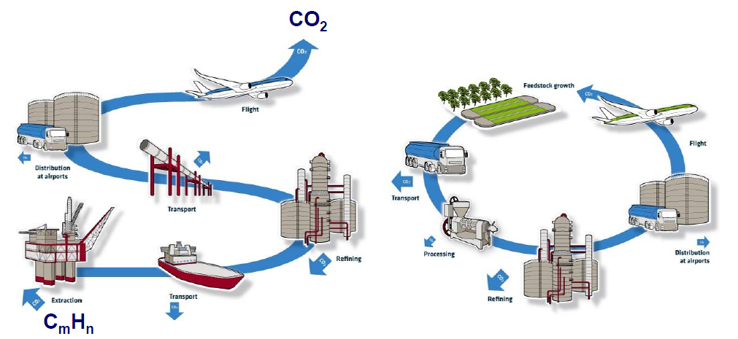
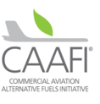
Achieving Net Lifecycle GHG Reductions With SAF
Petroleum based Jet
Sustainable Aviation Fuel
Result is a net reduction of additional GHG (CO2) being introduced into our biosphere.
Acquiring the majority of our carbon from the atmosphere, via biology or recycling, and turning it back into fuel
Continuing to pull additional carbon from the ground and releasing it into the atmosphere as CO2

Slide 6

Sustainability/SAF Overview
Business Aviation & SAF
SAF approved for turbine aircraft as a “drop in”
Approved by OEMs and by ASTM
Recommended by FAA, EASA and other int’l agencies
Supported by GAMA, NATA, NBAA, IBAC, IATA, A4A, CAAFI, IATA, ICAO
450,000 flights have flown using SAF

Slide 7














Sustainability/SAF Overview
Worldwide SAF Production Capacity Forecast*
Lakeview
6
Paramount
Cartagena 20
Net Zero 1 22.5
Speyer 22.5
Porvoo
Delfzijl
33
two locations 24
Rodeo 290
Altalto
Immingham 16
Silsbee
Singapore 330
Rotterdam 130
La Mede
Grandpuits 56
Bayou
Natchez, MS 33
Gela
Freedom Pines 10
Gary, IN 21
Gothenburg
70
IATA reports as much as 1.9B gpy capacity (Waypoint 2050 analysis)
Castellon
Paramount+ 150
3 Int’l locations 90
Sierra
~70+ M
~600+ M
~800+ M
~1,330 M
~1.4 B +
* Announced intentions. Not comprehensive; CAAFI estimates (based on technology used & public reports) where production slates are not specified

Slide 8
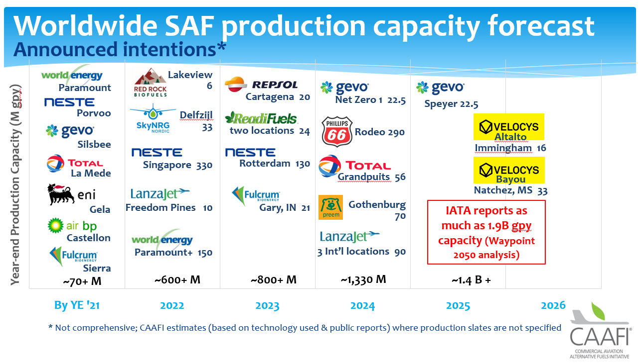
REFINERS AND PRODUCERS – Landscape early 2022
Leverage New
Technology
Develop Sustainable
Aviation Fuel (SAF)
Introduce electrified or
hybrid propulsion
Improve aircraft efficiency
Expand
Infrastructure
Build the SAF supply chain
Enable SAF purchases
Grow independent SAF credit purchases
Find Operational
Efficiencies
Modernize airspace,
direct-to routing
Sustainable flight ops practices & procurement
~20M

Slide 9
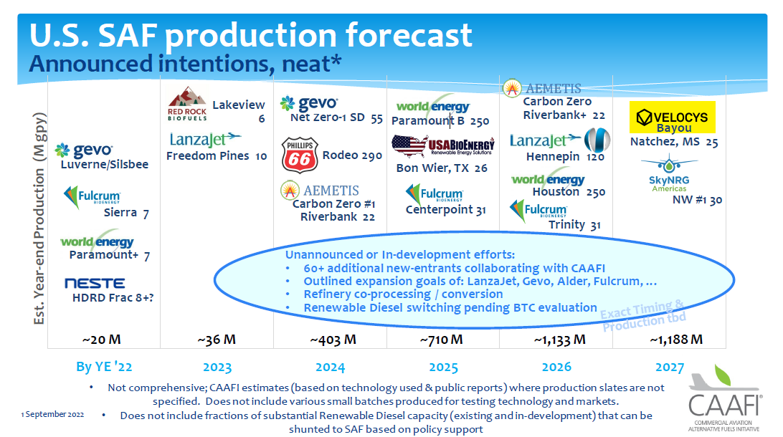
REFINERS AND PRODUCERS – Landscape early 2022
Flight Plan to Sustainability

Slide 10
Sustainability/SAF Overview
Today’s Jet Fuel Supply Chain
Overview of Avfuel’s Fuel Supply Chain Expertise, from Refinery to Wingtip
Intermediate Storage &
Blending
On Airport Refueler Trucks
Fixed Storage
Aircraft Fueling
Refining
Shipping
Transport
      FBOs
      Airports
      CFDs
      Charter Ops
      OEMs
      Airlines
      Cargo Ops
Refineries 137 USA
18 Canada

Slide 11
















Sustainability/SAF Overview
SAF is a Drop-in Solution to the Existing Fuel Supply Chain & Infrastructure
Waste & residue
Renewables refinery + distillation
Corporate Flight Dept/FBO/Airport
storage
Blending
terminal: ASTM 7566 Certification
And ASTM 1655 recertification
Refueller/
Hydrant
Crude oil
Fossil refinery

Slide 12
SAF Progress
Common SAF Questions
What is the price of SAF?
Will the delta between refined jet and SAF pricing narrow?
What is the projection for volume growth?
What incentives are being developed to increase supply and meet/generate demand?
Why is SAF supply and demand focused on the West Coast of U.S./Canada?
Why is SAF documentation so important to customers?
What is book and claim?
How do carbon offsets apply to business aviation?

Slide 13
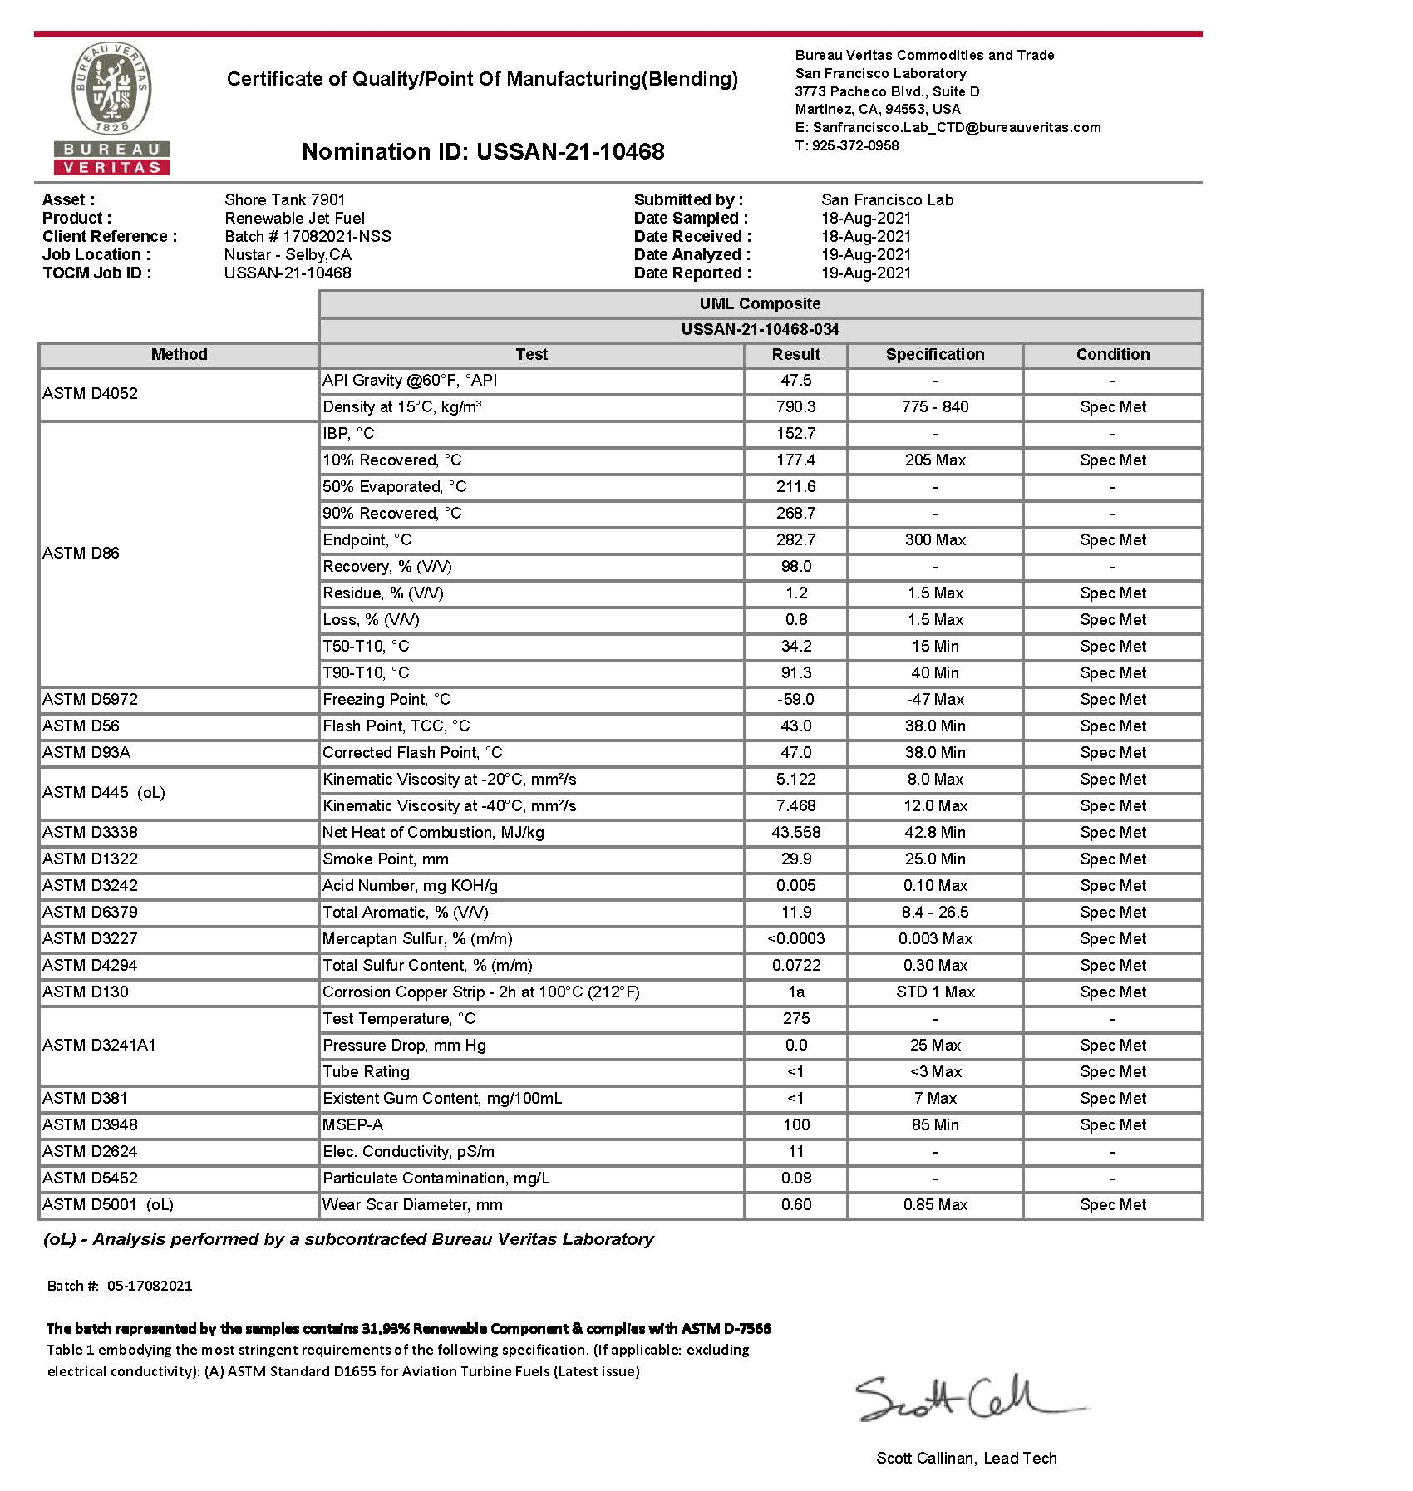
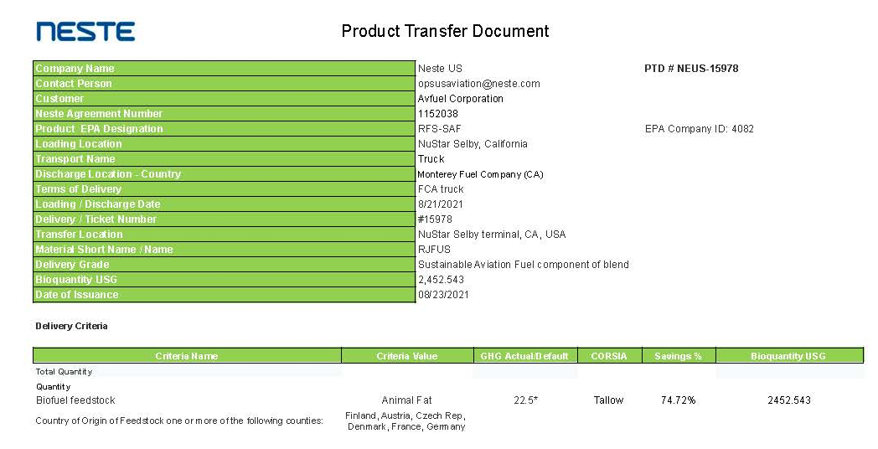
Common SAF Questions
FBO
% Renewable Component Documented

Slide 14
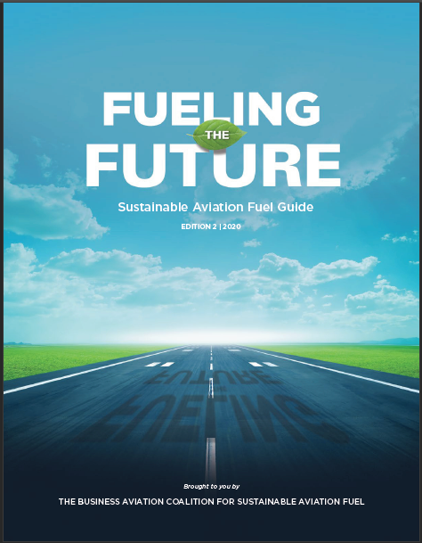
Resources
Information, Brochures, Blogs, Recordings and News at …
https://www.futureofsustainablefuel.com/#resources
Notes:
Graphic that shows the fueling the future guide

Slide 15
No Lead Avgas Update…
Notes:
Graphic that shows the fueling the future guide

Slide 16
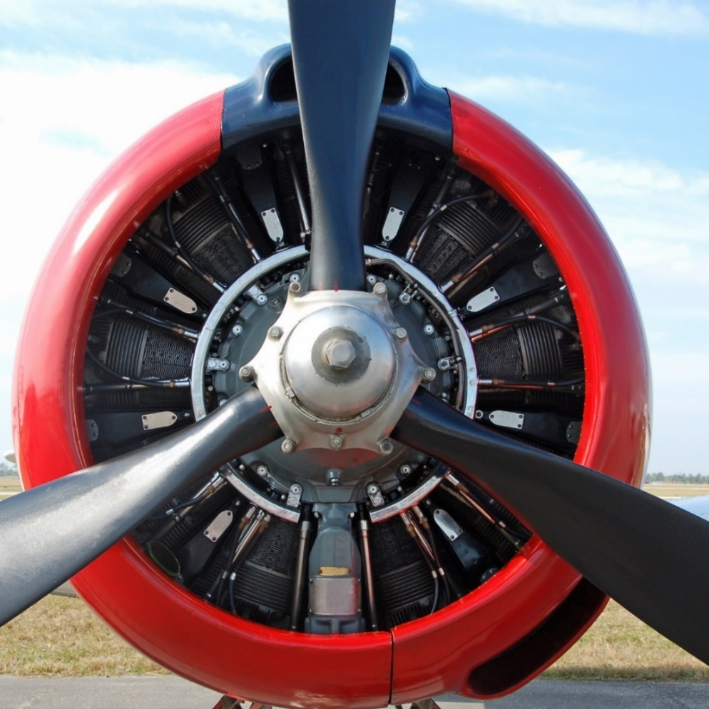
Wish List for an Unleaded Avgas
Must be safe to store, handle and burn
Functional in all existing piston aircraft and fuel systems
No aircraft modifications necessary
Affordable
Miscible with 100LL
Use existing 100LL infrastructure

Slide 17
Unleaded Initiative – Pathway #1
PAFI – Piston Aviation Fuels Initiative
  Early pathway to UL avgas approval; disbanded in 2019
EAGLE – Eliminate Aviation Gas Lead Emissions
  Industry group formed in 2022 to facilitate unleaded solution
  Self-imposed deadline of 2030
  Four Pillars:
    Regulatory and Policy
    Unleaded Fuel Testing and Qualification
    Research and Development
    Supply Chain Infrastructure and Deployment
  Afton Chemical/Phillips66 and LyondellBasell/VP-Racing

Slide 18
Unleaded Initiative – Pathway #2
FAA Supplemental Type Certificate (STC)
  FAA testing has been on-going for years
  Swift Fuels
    STC available for UL-94, covering 75% of piston fleet
    Working on approval of 100-octane unleaded avgas (100R)
  GAMI (General Aviation Modifications, Inc.)
    Has received functional FAA fleet-wide approval for 100-octane unleaded fuel (G100UL)

Slide 19
Additional Information
https://www.avfuel.com/Fuel/Alternative-Fuels/Unleaded-Avgas#FAQ
https://www.faa.gov/unleaded
https://www.aopa.org/advocacy/100-unleaded-avgas
https://www.avweb.com/author/paulb/
Keith Sawyer, Manager of Alternative Fuels, Avfuel Corporation ksawyer@avfuel.com

Slide 20
Thank you!
Notes:
Graphic that shows the fueling the future guide

