Slide 1

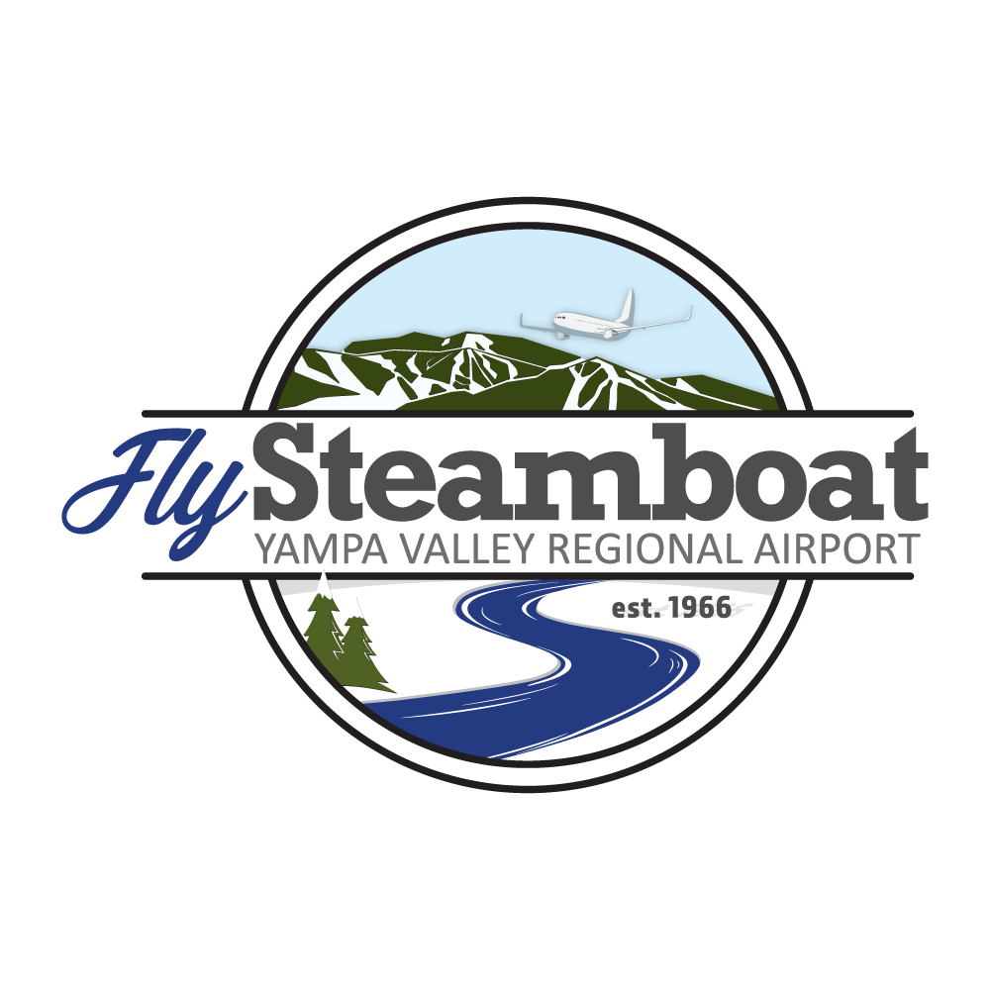
Situational Awareness System (SAS)
Yampa Valley Regional Airport (HDN)
25 January 2021
Kevin Booth, Airport Director

Slide 2

YVRA’s Situational Awareness System (SAS)
YVRA Overview:
  Busy, but “uncontrolled” regional airport; 5-6 major airlines & 12-24 commercial flights per day in the winter
    13,307 operations in 2020; >120 daily ops on busiest days; daily average is 36 ops
    >50% of commercial flight ops occur between 1000-1400
  Air service supports the Steamboat Springs ski industry and the Yampa Valley (Routt & Moffat Counties)
  Challenging weather conditions with high snow removal ops tempo during snow events:
    4-10 pieces of SRE and vehicles and in the safety area at any given time
    Control previously reliant on internet flight tracker, visual and radio communications
Why SAS?
  Enhance situational awareness and safety for YVRA Ops Center (ARFF), aircrews, and maintenance personnel
  In lieu of and/or in addition to a remote tower solution which may not address SRE/vehicle tracking
  Increased SA for personnel who may be operating without Ops Center support (open/close/inspections…)
What is SAS?
  Combination of tracking info on aircraft and SRE/vehicles displayed in Ops Center and in SRE/vehicles
    Two work stations in Ops Center; 10 tablets for SRE/vehicles
  Combination of Saab Aerobahn Surface Management Suite and GPS tracking solution
    Proven capability fielded at 28 airports worldwide (LAX, ATL, EWR, JFK, PHX, SEA, ORD, DEN, DCA, DFW…)

Slide 3
YVRA’s SAS System
Initial Operational Capability (IOC) at YVRA was mid-Dec 2020; ops testing and adjustments on-going
Proof of concept for Saab’s first reduced-scale, lower cost system tailored to regional airport needs
Successes:
  Highly accurate and timely position data on aircraft (air or ground) and SRE/vehicles
  Significantly more aircraft data available from SWIM/ASDI vs. Flightradar24 or FlightAware
  Programmable alerts for aircraft and SRE/vehicle locations; sound and color change
  Dual work stations optimizes operations task sharing during busiest periods
  Info can be standardized or tailored for each Ops Center user
  Single source for airport flight schedule, weather and NOTAM info
  Lots of additional capabilities we’re still learning about; reporting, tracking
  Good support from Saab
Challenges:
  It’s new and it brings change to our organization
  Some connectivity issues
  Some reliability issues; false contacts and wrong distances at long range
  Terminology and acronym use needs to be tailored to non-IT users
  Need a night mode for tablets similar to work stations

Slide 4
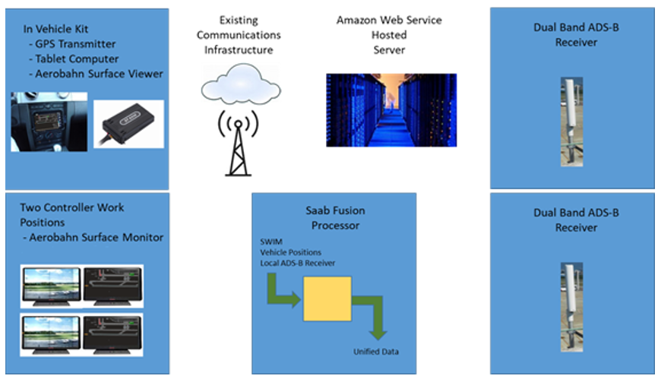
SAS System Architecture
YVRA provided FAA SWIM subscription, broadband access/architecture and enhanced cellular service via FirstNet

Slide 5
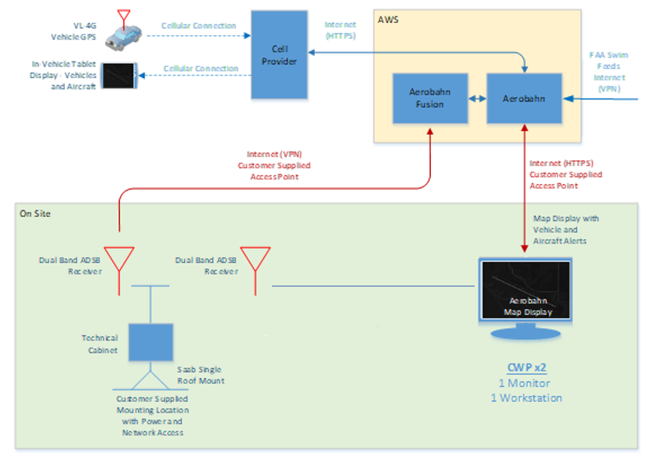
SAS System Architecture

Slide 6
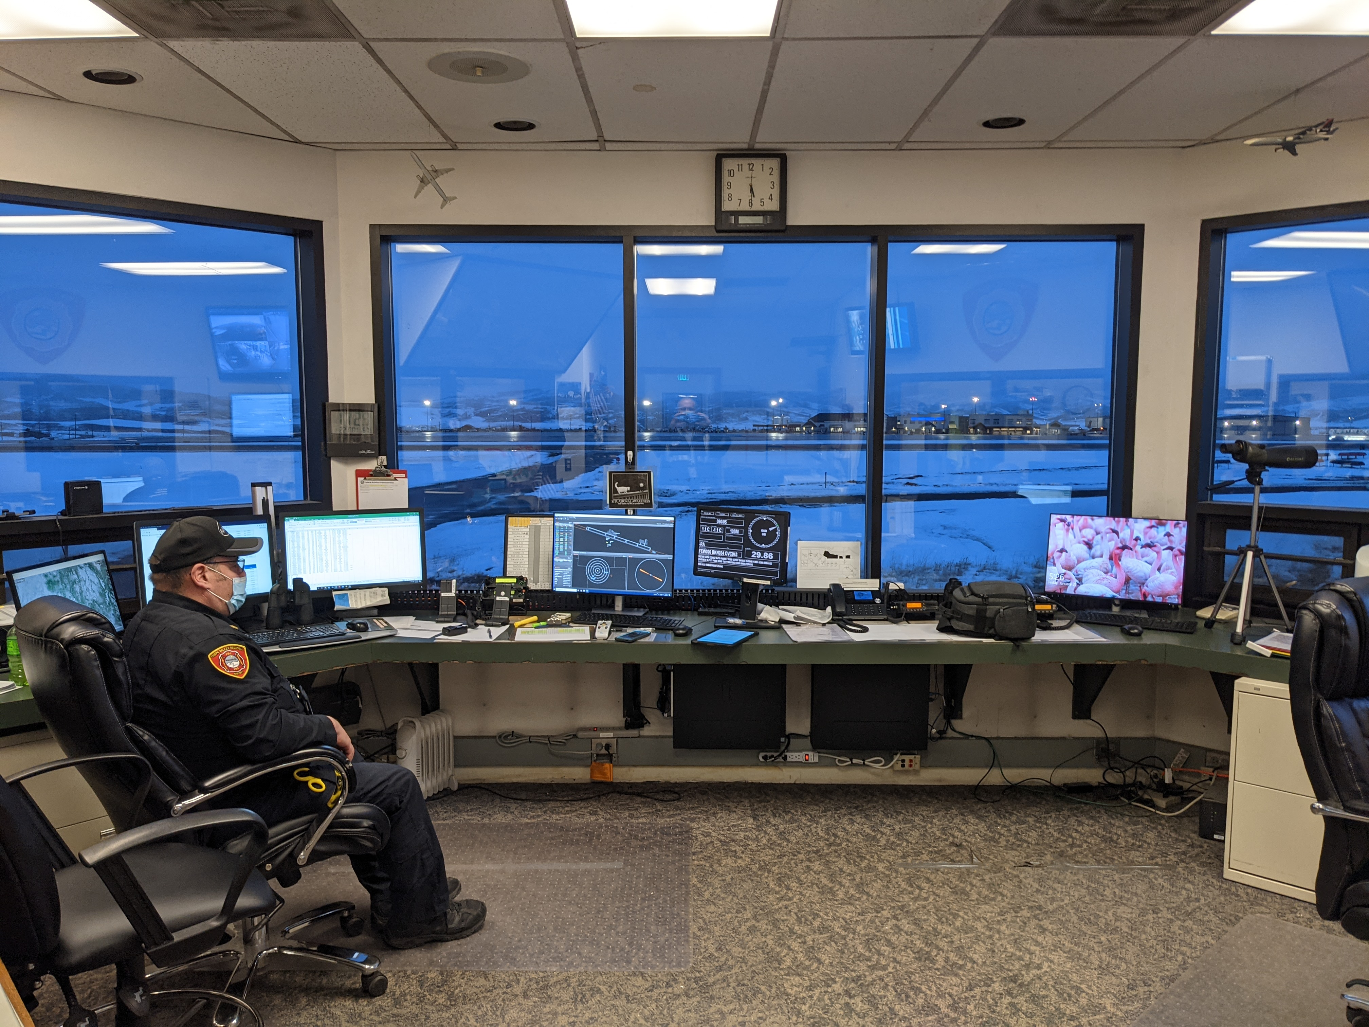
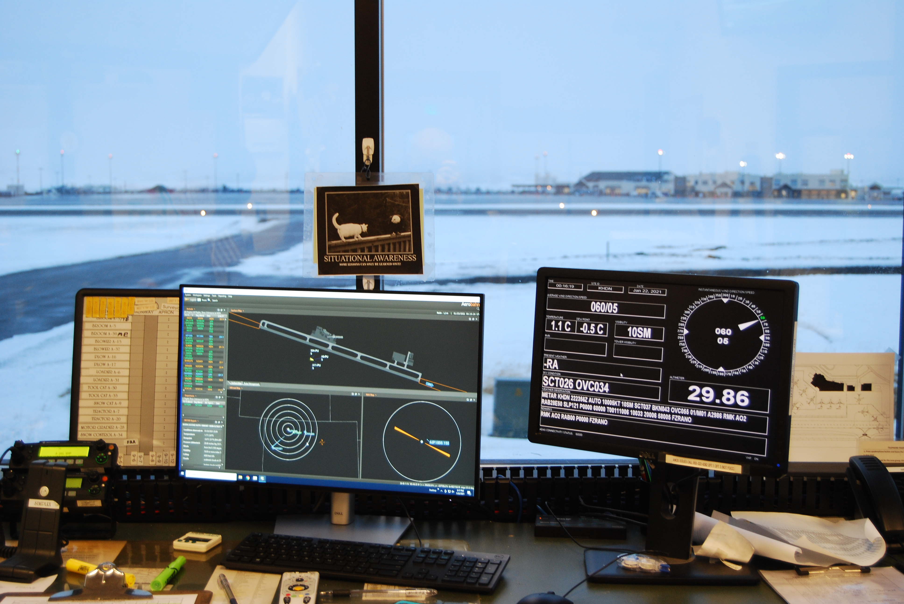
SAS System Ops Center Work Stations
Ops Center with two (2) work stations
Ops Center work station with AWOS display and manual SRE/vehicle tracking board

Slide 7
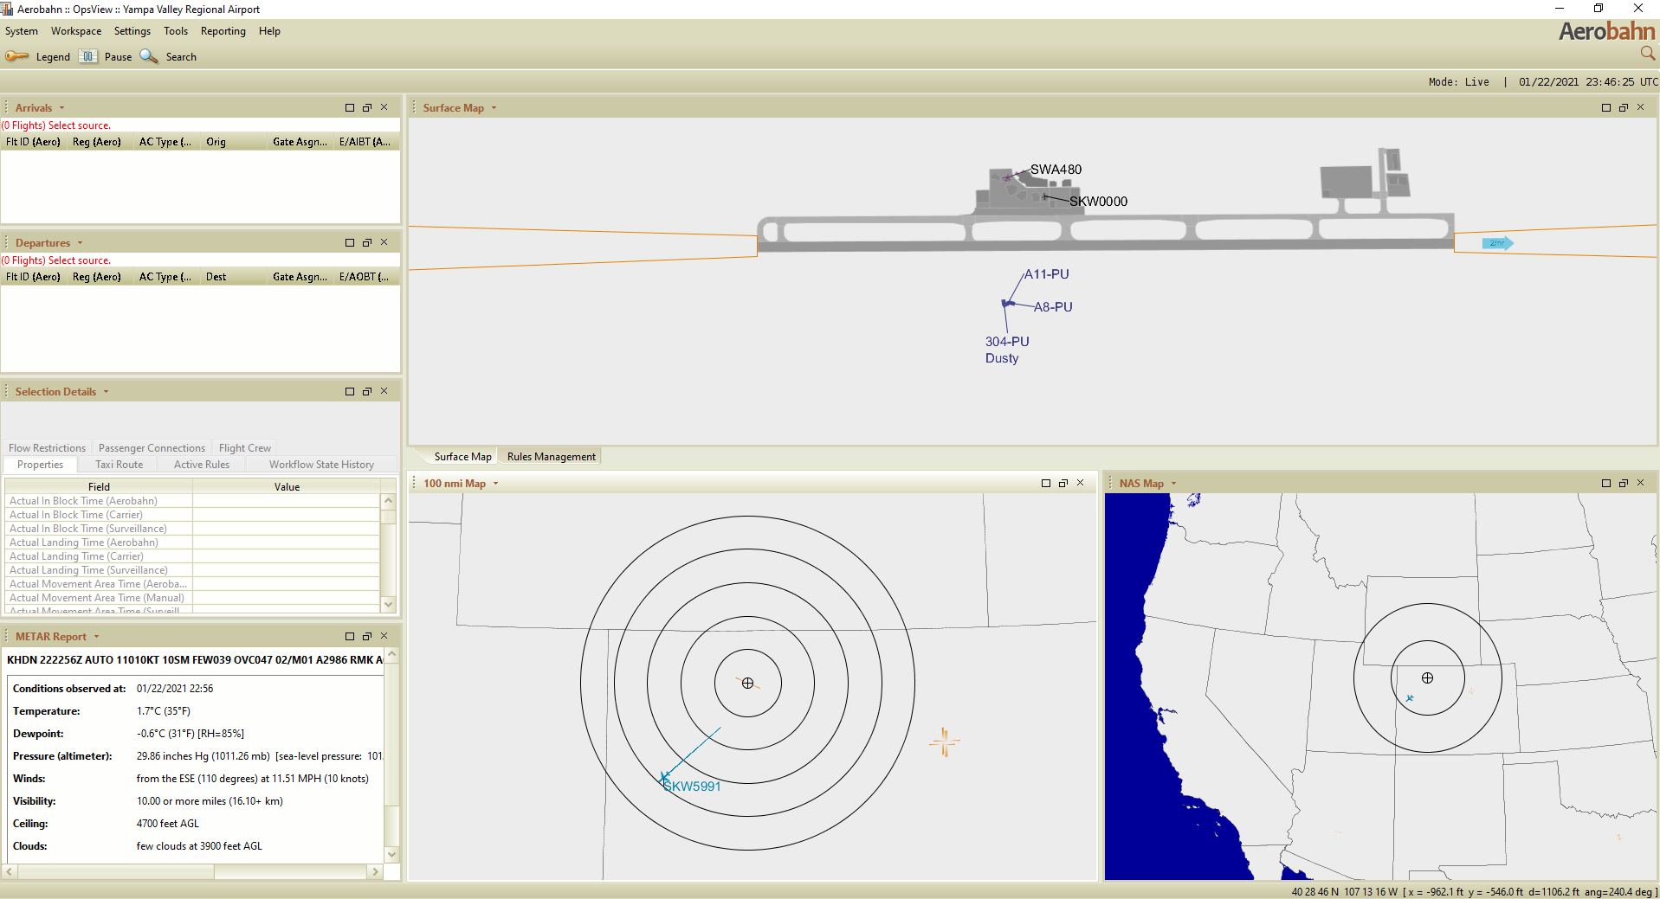
Workstation Screen Shot

Slide 8
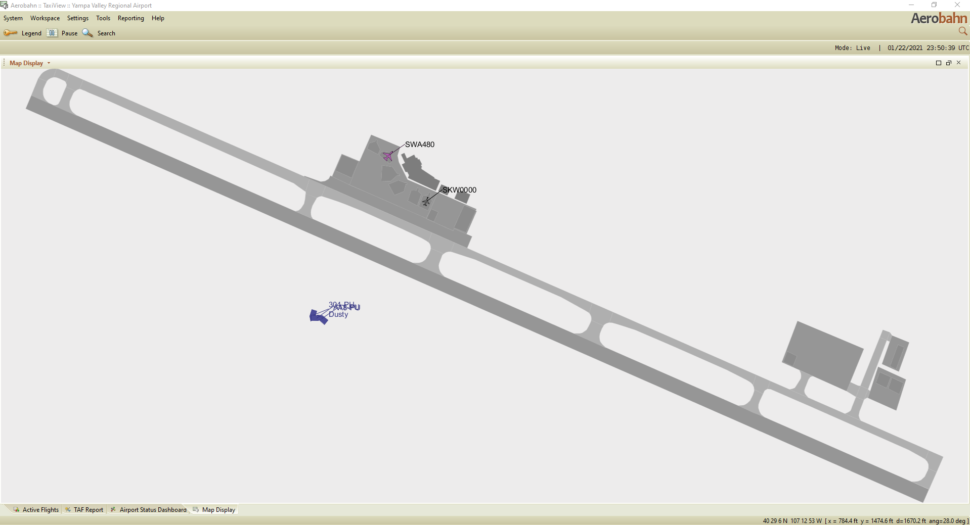
Workstation Screen Shot – Airport Diagram

Slide 9
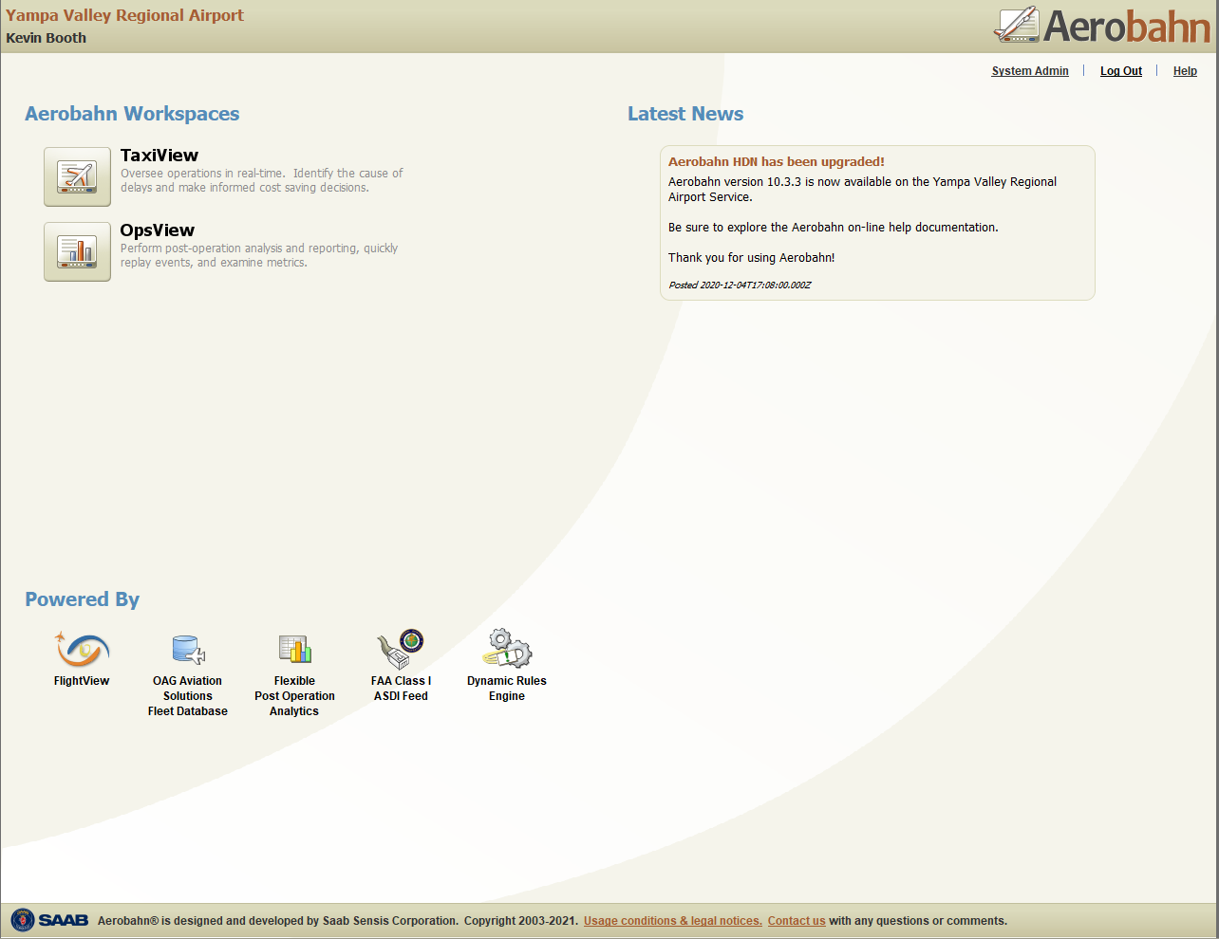
Tablet & Work Station Screen Shots
Workspace View Options
Data from FlightView, OAG, Flexible Post Operation Analytics, FAA Class I ASDI Feed and Dynamic Rules Engine
SRE/Vehicle Tablet

Slide 10
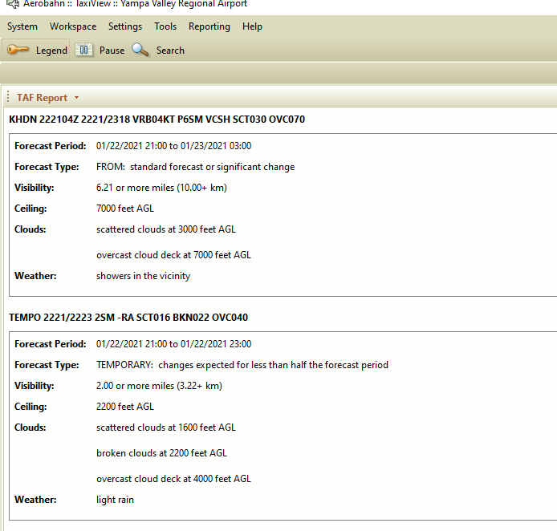
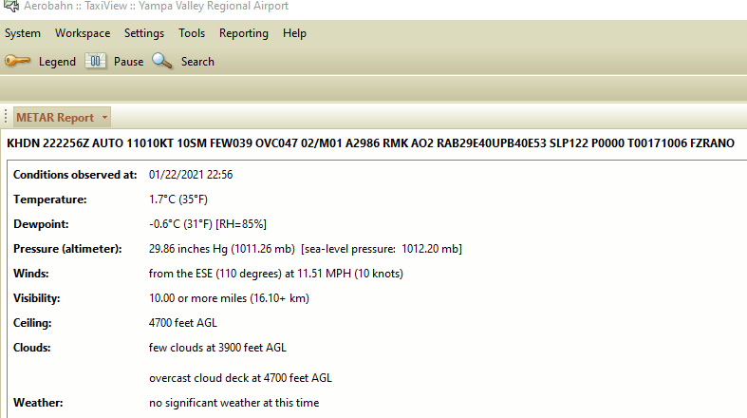
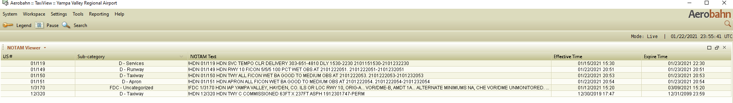
Workstation Screen Shots – Wx & NOTAMS

Slide 11
Questions?
My contact info:
Kevin Booth
970-276-5004
kbooth@co.routt.co.us

