Slide 1
2021 AOPA Initiatives and General Aviation Outlook

Slide 2
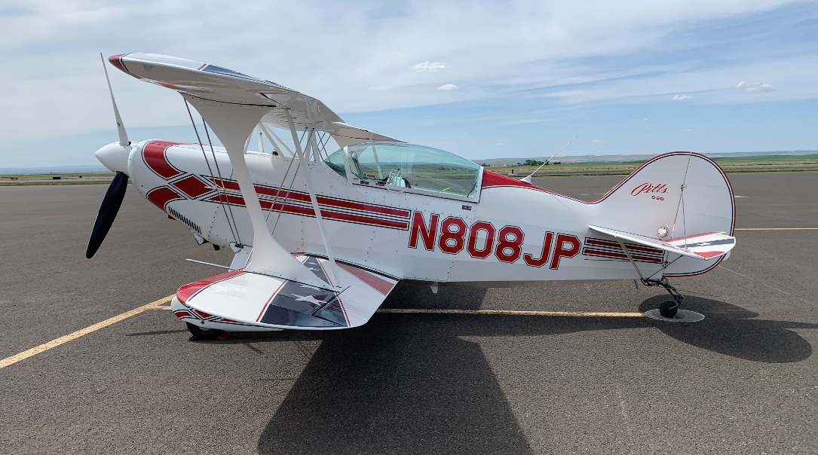
NW Mountain Regional Manager
Joined AOPA Staff in 2019
Advocacy at the Regional, State and Local Levels
CFII, MEI, Seaplane & Aerobatic Pilot, Homebuilder & Aircraft Owner
Based at 7S9 and UAO

Slide 3
NW Mountain Region at-a-Glance
State | FAA Active Pilots | AOPA Members | Total GA Aircraft | Public Use Airports | ASN’s
Colorado | 18,891 | 9,082 | 7,242 | 75 | 37
Idaho | 5,401 | 2,815 | 3,752 | 124 | 21
Montana | 3,984 | 2,132 | 3,188 | 128 | 35
Oregon | 9,603 | 4,988 | 6,229 | 97 | 47
Utah | 9,129 | 2,952 | 3,197 | 45 | 16
Washington | 21,089 | 9,995 | 9,996 | 135 | 61
Wyoming | 1,908 | 1,133 | 1,392 | 41 | 15
Totals | 70,005 | 33,097 | 34,996 | 645 | 232
Nearly 650 Public Use Airports
347 Airports are Eligible for Federal Funding (NPIAS)
Two of the Nations Top 10 Busiest General Aviation Airports located within the Region*
Centennial KAPA (3rd)
Hillsboro KHIO (6th)
*Source: FAA OPSNetData

Slide 4
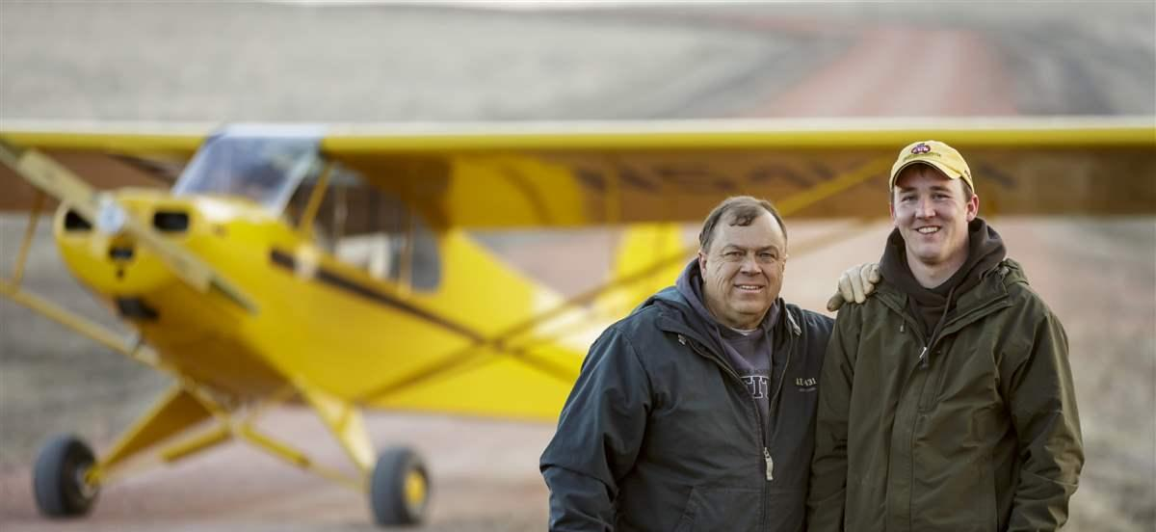
Airport Support Network
Launched in 1997 amid battle to save Meigs Field​
Preserve and protect airports across the United States
Vehicle for AOPA members to work in concert with AOPA staff
Works at a local grassroots level to build local airport support
Front-line force to anticipate threats​
​Current ASN Network is 1,800+ Volunteers Strong & Growing!

Slide 5
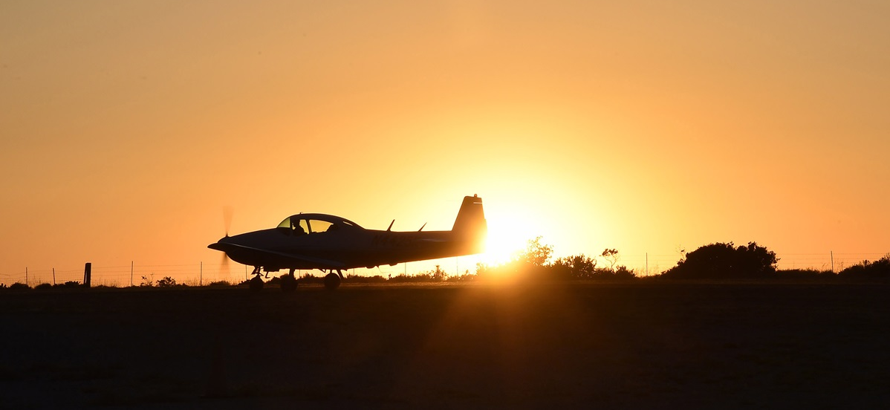
A Time to Celebrate General Aviation
GA $247 billion industry
GA employs 273,500 workers
GA flight operations around the country have returned to – and exceeded -- pre-COVID levels
Most flight schools are open again

Slide 6
GA is Providing Flexibility and Efficiencies
Increased use of GA for personal and business travel (rather than the airlines)
GA is served by more than 5,000 local airports across the country
In comparison, the airlines and now serve fewer than 500 airports

Slide 7
General Aviation Sales are Strong
In a recent survey:
20% of members are currently shopping for a new aircraft, or strongly considering one
30% of owners had a major overhaul, avionics upgrade or other major service done since March 2020
New and used inventory is thin, and moving fast
Prices for used aircraft are holding firm - or increasing

Slide 8
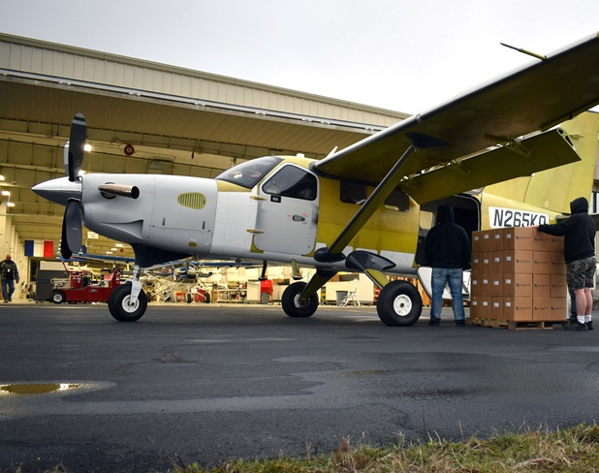
Photo courtesy of Daher
GA Has Greatly Contributed to the Fight Against COVID-19
GA moved a LOT of people and products
Manufacturers created – and delivered -- needed PPE and other equipment to help patients and front-line health care workers

Slide 9
Returning Pilots & Aircraft to the Skies
AOPA’s Air Safety Institute created two valuable guides to assist pilots returning to flying
These guides have been downloaded many THOUSANDS of times

Slide 10
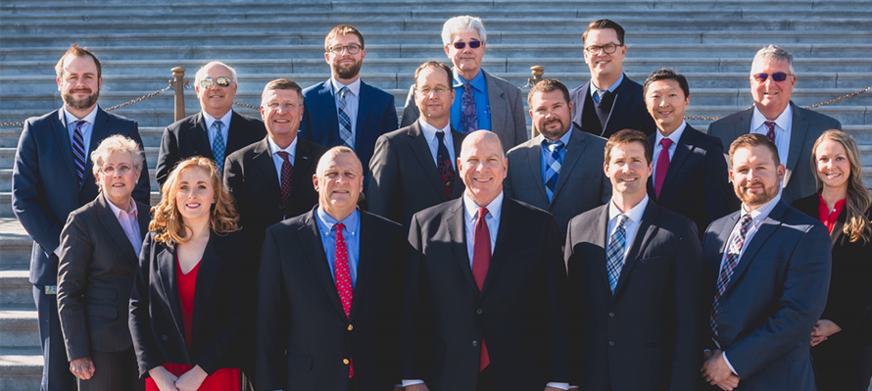
AOPA on the Legislative Front
SFAR extensions and COVID relief
Real-time Special Use Airspace in the cockpit (part of NDAA)
Pushing FAA to address shortage of DPEs across the country
More than 61,000 pilots are now using BasicMed
National Center for the Advancement of Aviation

Slide 11
National Center for Advancement of Aviation
Bipartisan bill
11 million jobs; 1.6 trillion economic impact
Supporting all segments of aviation
Workforce Development
Aviation and Aerospace STEM Curriculum
Economic, safety data and research Sharing
Forum for cross-disciplinary collaboration
Funded by Av Trust Fund interest income

Slide 12
Insurance Options in Tightening Markets
Insurance for many pilots has increased significantly – in some cases between 10% - 100% or more
Working with Assured Partners to explore insurance solutions
Ensure that applicants for insurance are evaluated fairly and not just by their age

Slide 13
Looking to the Future
You Can Fly program
High School Initiative
Flight Training Initiative
Flying Clubs
Rusty Pilots Program

Slide 14
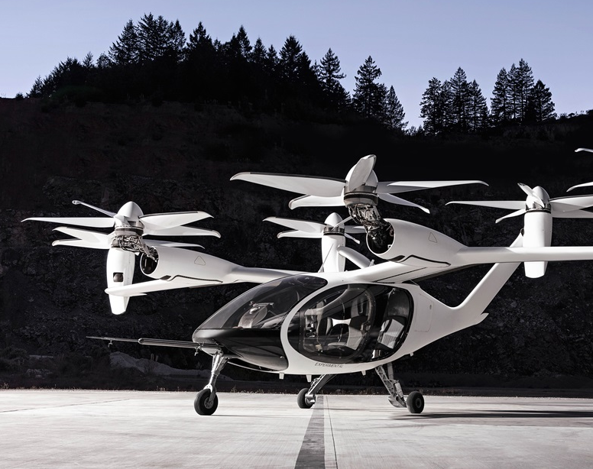
The Greening of Aviation
Ongoing development of eVTOL technology
PAFI Steering Group for unleaded avgas alternatives
Showcasing new, innovative and efficient designs

Slide 15
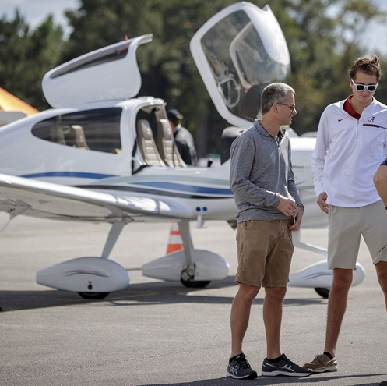
2021 AOPA Air Tours and Fly Ins (planned)
AOPA Aviator Showcase
Two locations for 2021
AOPA Pilot Gathering Air Tour
Two separate tours for 2021

Slide 16
AOPA SWEEPSTAKES
Aircraft
Congratulations Aaron Benedetti – Livermore, CA!
2021 sweepstakes aircraft is already in the works!

Slide 17
JOSH PRUZEK
NW Mountain Regional Manager
Government Affairs
o: 202-851-7502
c: 503-939-3018
www.aopa.org

